Slide 1
Welcome to the Maths Department
Year 7 Partnership evening
Mr Simon Miller

Slide 2
Maths Staff
Mrs J Gregg (Head of Maths)
Mrs K Taylor (KS3 coordinator)
Mr S Miller (KS4 coordinator)
Mr R Oldfield (KS5 coordinator)
Mrs L Doran
Mr J Binyon
Mr J Blackmur
Mrs A Sawa
Miss J Evans
Miss R McAvoy (maternity)

Slide 3
Mastery in Maths
We have identified 3 key skills in Maths: fluency, reasoning and problem solving
Each lesson will focus on these three skills, with specific questions focussed on each area
The aim is for all students to gain a deeper understanding of each topic
The mastery curriculum will run in Year 7 and Year 8. In Year 9 they will start their GCSE course

Slide 4
Fluency
Skill | Aspiring | Expected | Exceptional
Accuracy | Work with guidance to follow methods to derive correct answers | Work independently to follow methods to derive correct answers Work independently to arrive at correct answers and present them clearly and with accuracy (including any units). | Show all the appropriate steps with clarity in order to arrive at a correct solution. Present the solution with accuracy.
Efficiency & Flexibility | Know a method to get to a correct solution | Explore different methods which lead to the same results Identify the most efficient method to get a solution and present it clearly | Use a skill in order to answer simple non-standard questions

Slide 5
Reasoning
Skill | Aspiring | Expected | Exceptional
Explaining methods | Describe a given step in the method to getting a correct answer | Explain the whole method needed to reach a correct answer Explain the whole method needed to reach a correct answer using accurate terminology throughout | Explain how the mathematical structures behind a correct method work
Errors & Generalising | Identify mistakes in a worked solution | Correct mistakes in a worked solution Explain misconceptions verbally and make corrections | Generalise the method used verbally

Slide 6
Problem solving
Skill | Aspiring | Expected | Exceptional
Identifying skills | Highlight keywords in a problem in order to know how to start solving it | Identify the key mathematical points that need to be used to solve a problem Identify all the steps needed to solve a multi-step problem on any given topic | Identify all the steps to solve a multi-step problem including any connections to previous topics already covered
Applying skills | Find the first step to solve a problem, or draw an appropriate diagram, with support | Independently find the first step in answering a problem or draw a diagram to help me start answering it Put together multiple steps to be able to answer a problem | Present a method and solution to a problem efficiently, clearly and accurately

Slide 7
Assessments
Students will be assessed at least once per half term
Each test is broken down into 3 parts, with questions on fluency, reasoning and problem solving
Students will all receive a grade (aspiring, expected, exceptional) for each of the 3 skills
Students will receive an overall grade (aspiring, expected, exceptional) available on Go4Schools

Slide 8
GCSE
The students are assessed with three 90 minute exam papers
In two of these papers a calculator is allowed, one paper is non-calculator
Any of the material covered can be assessed across the three papers

Slide 9
Setting in Maths
Students were placed into sets during third week of term
Sets were produced based on from a Midyis test; taken in their first week at school and an internal baseline test sat in class
Sets are flexible and reviewed throughout the year following assessments
Students are placed in sets to help them make the most progress possible

Slide 10
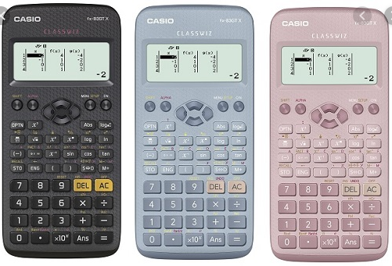
Equipment
We ask students to bring a protractor, compass, ruler and calculator to all lessons. Maths pack £1.50
The calculator we recommend is the Casio FX83GTX Classwiz sold £10 in school (RRP 14.99)
Two of GCSE exams are calculator papers, it is important students get used to their calculator
White board pens 50p

Slide 11
Homework
Students will receive 40mins worth of homework a week
Some will be set through Teams and be completed in their books
Some will be set on Hegarty Maths
https://hegartymaths.com/

Slide 12
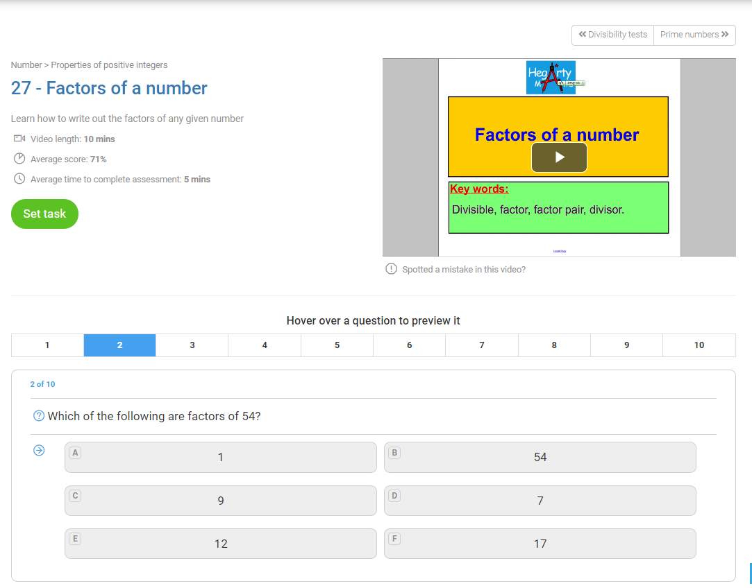

Slide 13
