Slide 1
Year 7 Partnership Evening

Slide 2
Steps to logging into Go4Schools
The following slides will take you step by step into being able to log into Go4Schools.
This site will allow you to monitor your child’s progress throughout the year.
You will be able to see:
Timetables
Reports
Teachers
Cautions & House Points
Current Grades

Slide 3
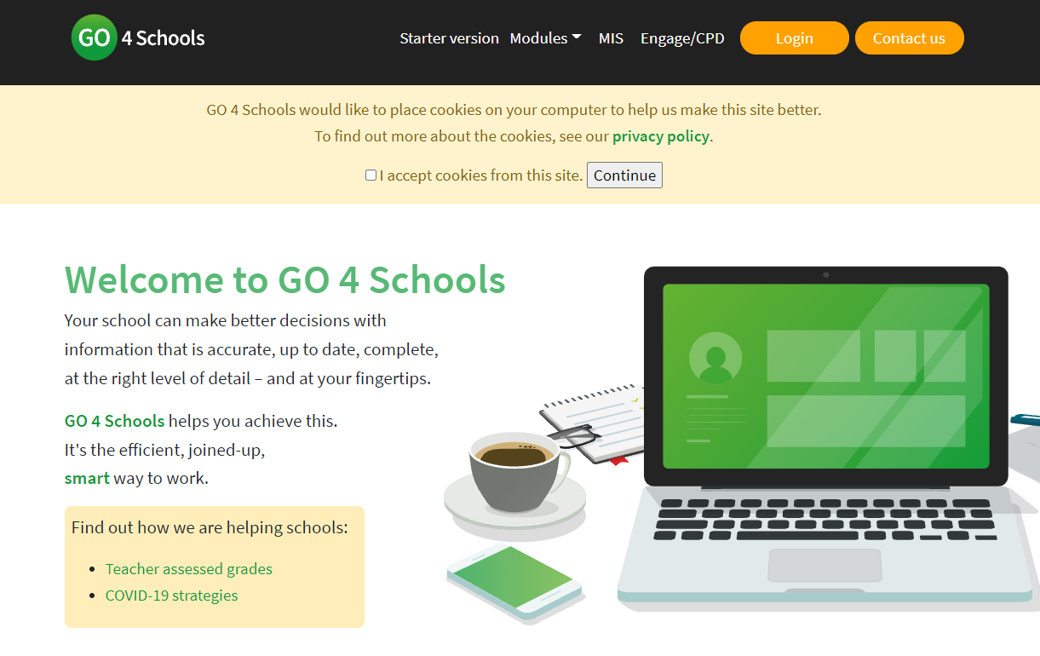
https://www.go4schools.com/ and then click on “Login”

Slide 4
Select the “Parents Login”

Slide 5
Select the “First-time User?”

Slide 6
Enter email in section requested

Slide 7
Once you have reset password and entered again, you should get this page
Here you can see:
Form class
HP’s & Cautions
Timetable
Teachers
Current Grades

Slide 8
You are also able to see graphs on progression and reports
When reports are ready, they shall appear at the top of the page in a highlighted section.
They shall also appear at the bottom of the page should you need to reread a report.

